Slide 1
Constitution Making of Pakistan
  Presidential system
  vs.
  Parliamentary system
Notes:
Minahil starts

Slide 2
Group Members
Minahil Shahid
Izza Maryam
Muhammad Zain
Muhammad Awais
Shahroz Khan

Slide 3
What is Constitution?
Why it have great Importance?

Slide 4
Efforts of Constitution making before 1956
Interim constitution
Objective Resolution
1st BPC Report
2ND BPC Report
Bogra Formula
Dismal of Assembly by governor general

Slide 5
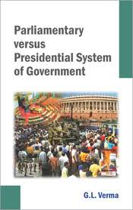
Difference between
Parliamentary System.
Presidential system.
Their Advantages
Their Disadvantages
Notes:
Shahroz khan

Slide 6
Major Causes of delay in 1st constitution
Power distribution among provincial and federal government.
Insincere leadership.
National Language.
Islamic State or Secular state.
Lack of consensus b/w East and West Pakistan.

Slide 7
Failure of 1956 Constitution
Lack of leader ship
Lack of Political Training
Delay in Elections
Lack of State Parliamentary System

Slide 8
Constitution of 1962
Why it was Presidential?
Failure of constitution of 1962.
Reasons of failure.
Constitution add by given by one man
Absence of fundamental freedom
Absence of Check and Balance.
Domical provincial Autonomy
Presidential dictatorship .

Slide 9
Constitution of 1973
Why Parliamentary system?
1962 Constitution bad experience.
Bhutto against parliamentary system?
Changes in parliamentary system

Slide 10
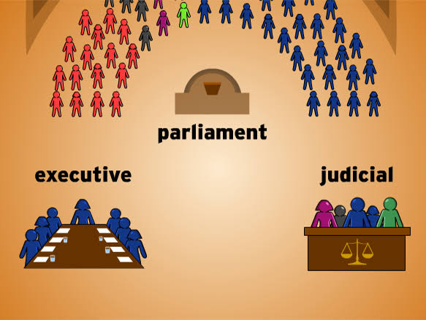
Parliament
Executive council and Judicial council

Slide 11
Opinion about Presidential and Parliamentary system
Presidential system never tried so far
Inherent flaws of Parliamentary System
Monopoly of MNA’s and MPA’s
Prime Minister Selection
Decisions by MNA’s and MPA’s
PM satisfying allies
PM authority
MNA’s and Nazism's Authority
President authority
Take decision

Slide 12
And this is for you mates
Whether its a Presidential system or Parliamentary system ,We will not be able to make any progress until we change ourselves to be a better human.

Slide 13
Thank you

